Slide 1
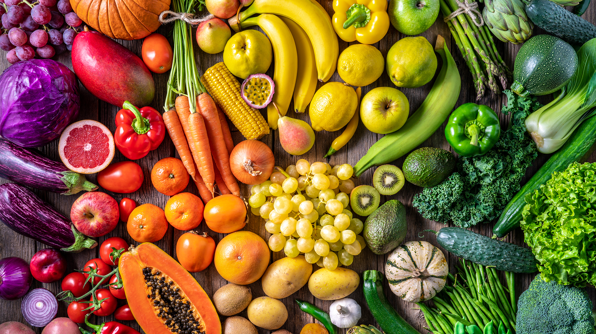










GreenGive
Name: Susan (Lientjie) Colahan
GitHub username: LientjieColahan
City & country: Cheltenham, UK
Date of recoding: 2024-04-07
Notes:
I would like to introduce you to GreenGive a database that is set up to give the people who grow their own fruit and vegetables on their balconies, in their back yards and/ or at an allotment a way of sharing the fruits of their labour with like minded people. Since the days of home-grown sourdough starters and windowsill tomatoes, more people are becoming interested in where their food comes from and want to take on the challenge of growing some of their food themselves
Many people who grow food crops will invariably end up with an overflow of a particular fruit or vegetable at some point, which often results in these items being forced upon family and friends in vast quantities beyond anyone’s reasonable daily consumption limit.

Slide 2







Notes:
The GreenGive database is designed to give its users the ability to create a profile for themselves and let other people know about the wonderful food crops they have extra of by creating fruit or vegetable listings in the database. The listings contain all the important information about the fruit or vegetables such as where they can be collected from, how many or what weight there is up for grabs and even which inputs were used to grow the fruit or vegetable and if the inputs were organic or synthetic.

Slide 3


















Notes:
The idea is for people to use the database to document the extra produce they have available and then for someone else who has a need for that produce to easily find it and collect the items perhaps even swopping what they have picked up with some excess produce of their own

Slide 4
GreenGive
Name: Susan (Lientjie) Colahan
GitHub username: LientjieColahan
City & country: Cheltenham, UK
Date of recoding: 2024-04-07
Notes:
The GreenGive database will hopefully reduce the number of stomach aches the friends and family of the green fingered back yard farmers need to go through and reduce the waste of perfectly good healthy food.

